Slide 1
Research Progress
Using Neural Network to
Infer Information Flow
Presenter:
Hong-Wei Li , CITI Postdoc.
Notes:
1

Slide 2
Overview
Introduction
Design
Preliminary Results
Plan and Issues

Slide 3
Overview
Introduction
Design
Preliminary Results
Plan and Issues

Slide 4
Introduction
Information flow analysis
Understand information flow in programs/systems
Applications
information leaking detection, resource management, code optimization
Taxonomy
Static
High efficiency, large coverage, low accuracy
Dynamic
High accuracy, limited coverage, low efficiency
Notes:
掌握資訊在程式或系統中的流向

Slide 5
Introduction
MIT
Y. -H. Hung, B. -J. Jheng, H. -W. Li, W. -Y. Lai, S. Mallissery and Y. -S. Wu, "Mixed-mode Information Flow Tracking with Compile-time Taint Semantics Extraction and Offline Replay," 2021 IEEE Conference on Dependable and Secure Computing (DSC), Aizuwakamatsu, Fukushima, Japan, 2021, pp. 1-8, doi: 10.1109/DSC49826.2021.9346239.
Methodology
Log basic block history at runtime
basic block === code segment single entry, single exit, without branch
Replay tag propagation semantics of the basic blocks in the history

Slide 6
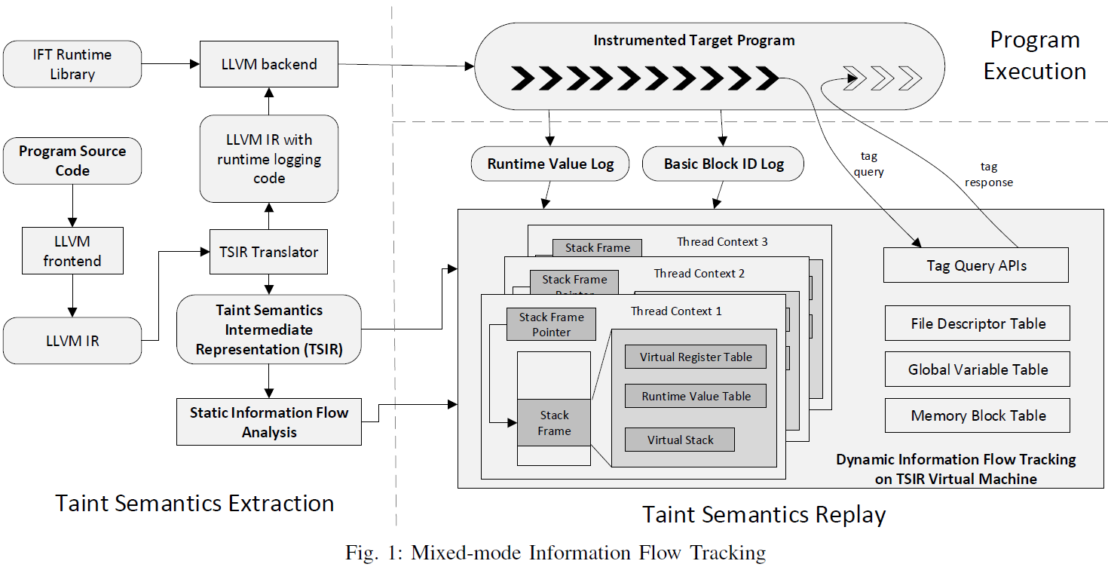
Introduction
Notes:
程式的code會經過 TSIR translator獲取其taint propagation的語義 (跳下一頁說明) 並在原本的code上加入runtime logging的code
在程式運行時 就會記錄所執行的basic block (和一些必要資訊)
然後再根據該歷史 replay對應basic block taint propagation語義 (in TSIR VM)
這種做法可以降低runtime logging所需要的代價(因為只需要記錄一點點資訊) 並且TSIR能夠減低replay的代價(不需要對整個code進行replay) PS: 其餘部分只是提供online分析功能

Slide 7
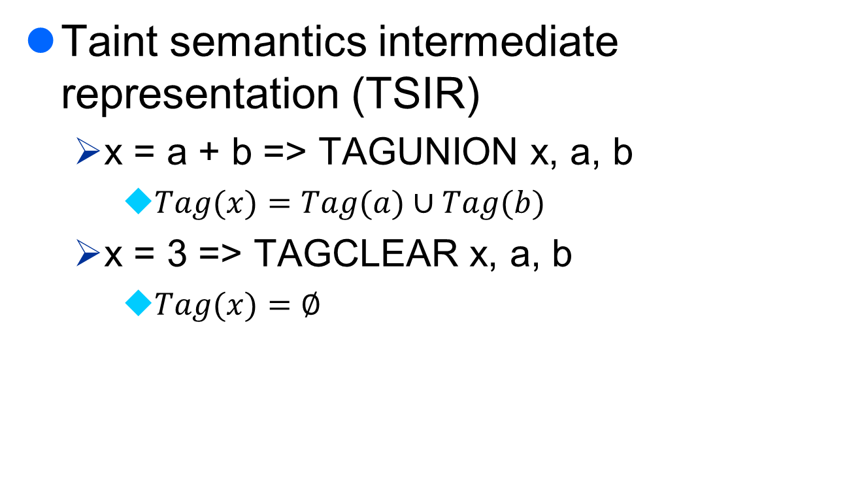
Introduction
Taint semantics intermediate representation (TSIR)
x = a + b => TAGUNION x, a, b
$Tag(x)=Tag(a)∪Tag(b)$
x = 3 => TAGCLEAR x, a, b
$Tag(x)=\text{∅}$

Slide 8
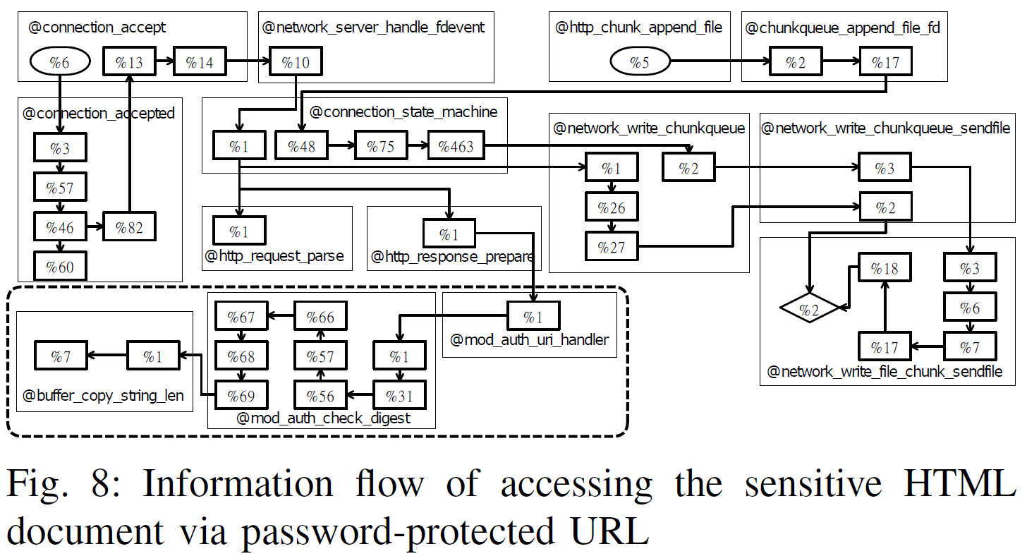
Introduction
Notes:
Anomaly detection 研究議題

Slide 9
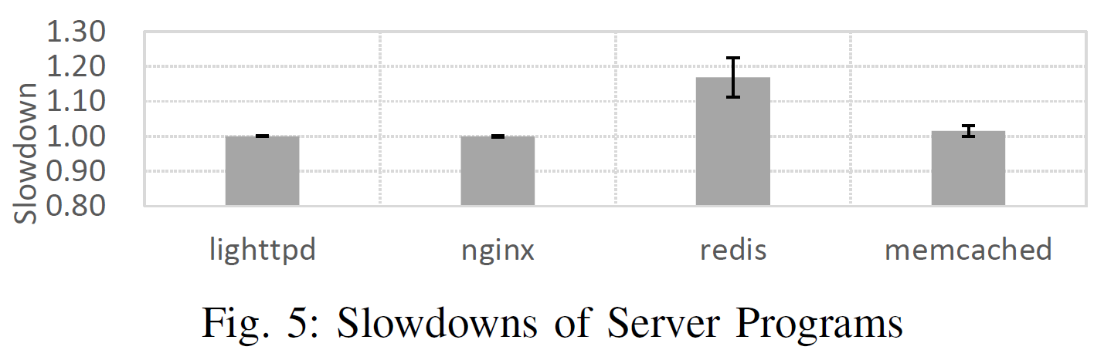
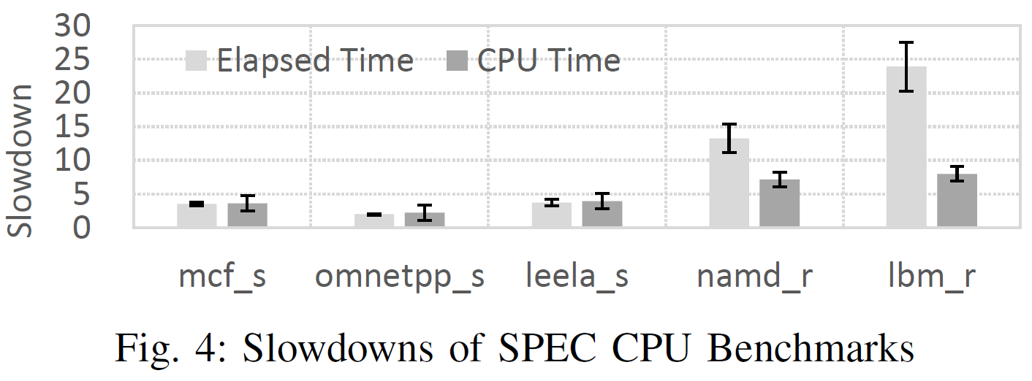
Introduction
Notes:
Slowdown在server program上沒有太大
但CPU-bound的程式影響就很大

Slide 10
Introduction
Motivation
loop usually causes longer history and higher replay cost
Example
int array[20]; For (int i=0; i<10; i++) { swap(array[i], array[20-1-i]); } …
history = <B1, B2, B3, B2, B3, … , B2, B4>
If a box can answer the flows of the loop, …
<B1, AskBox, B4>
Notes:
一部分原因是CPU-bound常常會有loop

Slide 11
Overview
Introduction
Design
Preliminary Results
Plan and Issues

Slide 12
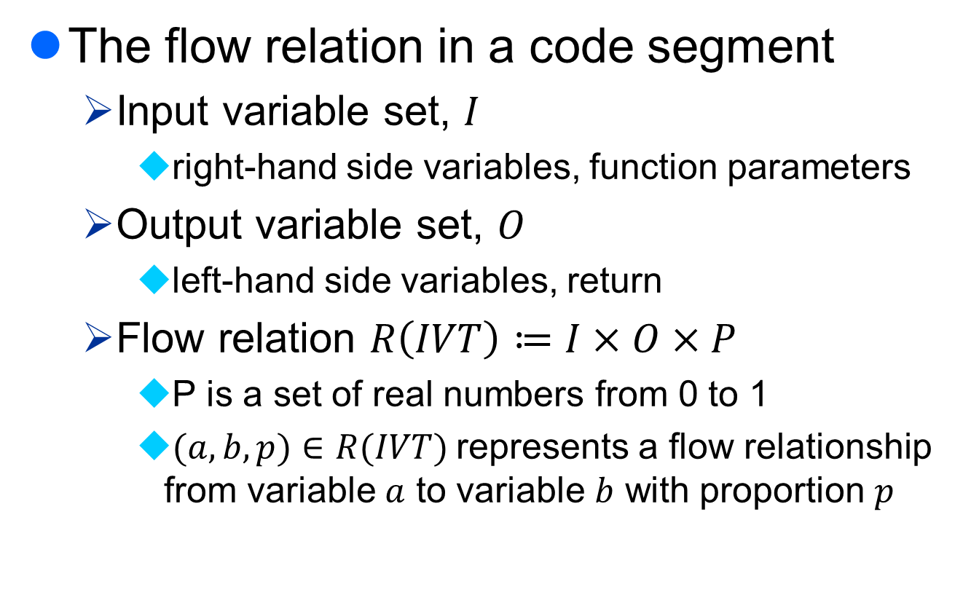
Design
The flow relation in a code segment
Input variable set, $I$
right-hand side variables, function parameters
Output variable set, $O$
left-hand side variables, return
Flow relation $R\left(IVT\right)≔I×O×P$
P is a set of real numbers from 0 to 1
$(a,b,p)∈R(IVT)$represents a flow relationship from variable $a$ to variable $b$ with proportion $p$

Slide 13
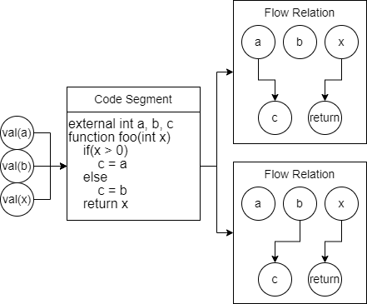
Design
input variable set
input variable value tuple
output variable set
Notes:
這段簡單的code input variable有a, b, x; output variable有c, return
我們希望用NN取代code input給 input variable value tuple 他會告訴我們flow relation
有了flow relation 現在 如果a帶有tag 我就知道tag的流向

Slide 14
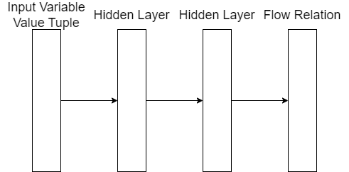

Design
Based on Fully-Connected NN
Flow relation is encoded as $\left|I\right|×\left|O\right|$ output neurons. $Dim=\left|I\right|×\left|O\right|$
Notes:
第一種是將每一個flow relationship encode成1個輸出
這樣就會有$\left|I\right|×\left|O\right|$

Slide 15
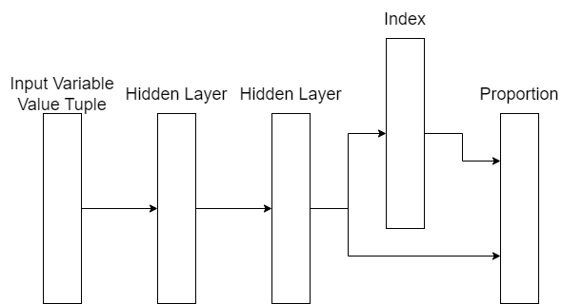

Design
Flow relation is usually sparse
each output variable has flows from which input variables (index) with proportion. $Dim=2×\left|O\right|×maxInputNum$
Notes:
但實務上flow relation通常是sparse 也就是一個變數通常只會被少數個變數影響到
所以有接下來的編碼方式 類似於稀疏矩陣的編碼
限制每個變數最多能被幾個變數影響

Slide 16
Overview
Introduction
Design
Preliminary Results
Plan and Issues

Slide 17
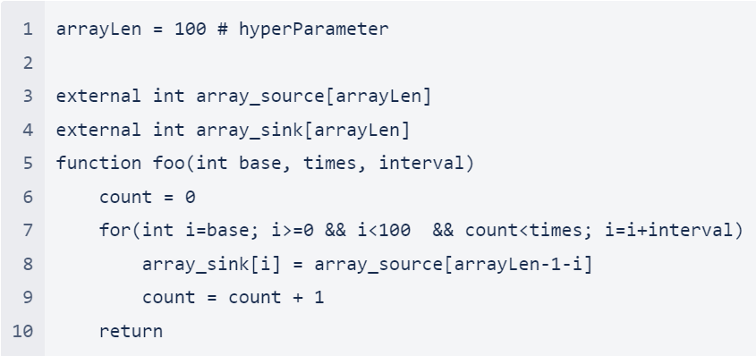

Preliminary Results
Code segment
$I=\left\{base, times, interval, array_source\right\}$
$O=\left\{array_sink\right\}$

Slide 18
Preliminary Results
Training/testing dataset (size = 10000):
base = {0.4~0.6} * array_len
times = {1~10}
interval = {-3,-2,-1,1,2,3}
array_source[i] = {-2147483648~2147483647}

Slide 19
Preliminary Results
Default configuration
Model
i_dim = 3+arrayLen, o_dim = arrayLen
hidden_layer_num = 2, DropOut = 0.1
Training hyperparameters
episode = 500, batch_size = 200, validation_split=0.1
EarlyStopping(patience=5, monitor = 'val_loss', mode = 'min')

Slide 20
Preliminary Results
Metrics
Sparse matrix encoding
index accuracy
proportion absolute error
Binary encoding
one hit rate (true positive rate)
(# of 1 hits) / (# of all 1)
zero hit rate (true negative rate)
(# of 0 hits) / (# of all 0)
proportion absolute error

Slide 21
Preliminary Results
Encoding
Encoding | Hidden Layer Dimension | Index Accuracy | Proportion Absolute Error | One Hit Rate | Zero Hit Rate
ArrayLen = 10
Binary | 130 | - | 3.38E-05 | 100% | 100%
Sparse | 30 | 74% | 1.55E-02 | - | -
Sparse | 10000 | 99% | 5.09E-03 | - | -
ArrayLen = 100
Binary | 10300 | - | 1.58E-03 | 92% | 100%
Sparse | 300 | 100% | 1.67E-02 | - | -
Notes:
Binary Encoding
NN輸出維度呈平方成長
需要根據資料調整loss function (penalty on false positive)
Sparse Encoding
NN輸出維度呈線性成長
限制某個變數最多只能被maxInputNum個數的變數影響
Hidden layer維度影響
過低會導致準確率低落
不確定是否與output維度有相依性

Slide 22
Preliminary Results
Training data size
Encoding | Training Data Size | Index Accuracy | Proportion Absolute Error | One Hit Rate | Zero Hit Rate
ArrayLen = 100
Sparse | 10000 | 100% | 1.67E-02 | - | -
Sparse | 1000 | 94% | 4.77E-02 | - | -
Sparse | 100 | 88% | 6.60E-02 | - | -
Notes:
Training data影響
資料越多越好，但效益遞減

Slide 23
Overview
Introduction
Design
Preliminary Results
Plan and Issues

Slide 24
Plan and Issues
Real-world data
Training dataset collection
Incomplete data
taint tag may not infer complete flow relations
Insufficient data
A code segment may not be run many times
Whether logging input variable values cost is tolerable
Code segment
size (the number of basic blocks)
input/output variable set size

Slide 25
Plan and Issues
Practical application verification
(statically or dynamically) Detect which code segments may cause long history
Normal run
record the flows in the detected segments
train a NN to infer the flow for each of the segments
Use the NN in replay and turn off the logging of the detected segments

Slide 26
Plan and Issues

Slide 27
Q&A

